Slide 1

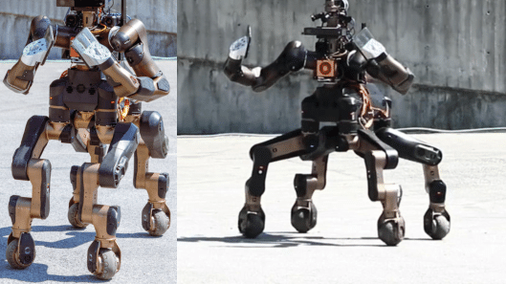
HumAnoid robots' seminar
Terrain Segmentation and Roughness Estimation using RGB Data: Path Planning Application on the CENTAURO Robot
Cüneyt Erem
Supervisor: Prof. Dr. Maren Bennewitz

Slide 2
MOTIVATION
In real-world, the robot needs to be more sensitive to respond to the environment
The robot centaur-like wheeled-legged CENTAURO should travel safely
Procedure: Terrain segmentation and roughness estimations modifications by end-to-end deep convolutional neural networks
Test: Dataset modification with terrain images and roughness values
The model applications on the Robot;
balancing configuration for safe traveling
leg configuration for path planning

Slide 3
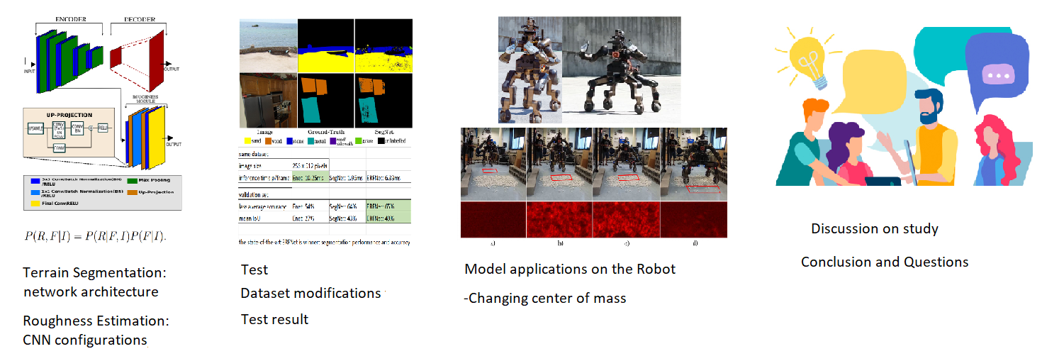
MOTIVATION

Slide 4
INTRODUCTION
Due to disastrous scenarios, wheeled and legged robots are used
The robot can identify the surroundings that make terrain segmentation and roughness estimation
It yields to create path planning with the algorithm and can travel securely
It adjusts its legs and body as well as its wheels
The training with CNN uses RGB data for performance issue

Slide 5
Relevant studies
Terrain segmentation:
Image exhibition by color, texture and features
Bell et al. [2] uses the Conditional Random Field (CRF) and CNN with sliding window approach
Wang et al. [3] uses Fully Convolutional Network (FCN) architecture for the 4D light field data

Slide 6
Relevant studies
Roughness estimation:
Howard and Seraji [4] evaluate by an image-based approach
J. Kimet al. [5] used RGBD camera and CNN architecture by reflection
S. Ram [6] uses data auto labeled with the metric that with SegNet
For this study, the method uses an end-to-end solution which is not proposed before

Slide 7
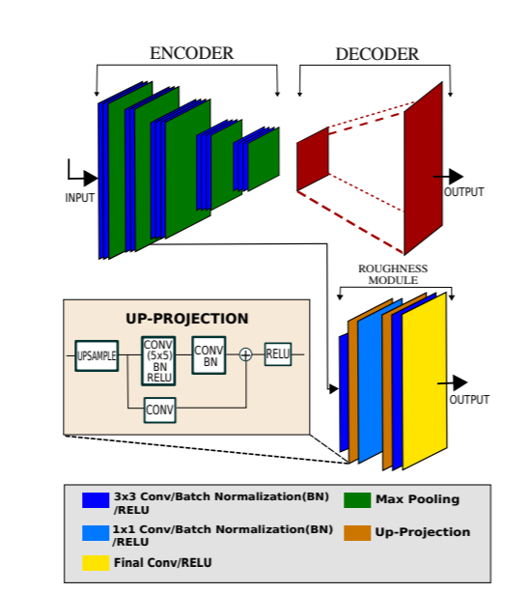
procedure
Terrain segmentation:
Deep convolutional encoder-decoder architecture
Encoder: feature abstraction SegNet (max pooling) and ERFNet (convolution)
Decoder: roughness estimation module, upsamples
Better performance and inference time than FCN architecture
Outdoor environments: data augmentation with flips and contrast changes
Fine tuned the weights on cityscapes dataset
RGB images resize dimension of 256 × 512
Median frequency balancing
label the predictions with threshold 0.4
Notes:
terrain segmentation:
-terrain segmentation uses deep convolutional encoder-decoder architecture,
-encoder extract features through pooling and decoder upsamples
-The method is implemented by SegNet (max pooling) and ERFNet (convolution) atchitectures because these have better performance and inference time (batch normaliyation and dropout layers) rather than FCN based architecture
-we use cityscapes dataset: it is outdoor terrain segmentation dataset
-outdoor environments have ambiguity, data augmentation like horizontal flips and contrast changes with 0.25 probability can handle
-For time efficiency, fine tuned the weights of pre trained models on cityscapes dataset
-Fine tune is done on RGB images with resize dimention of 256 × 512
-Median frequency balancing is used to compute the weights for the loss function
-confidence threshold is 0.4 experimentally to label the predictions 'unlabelled'

Slide 8
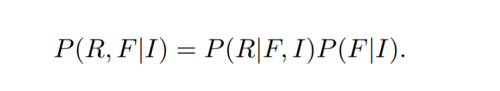
procedure
Roughness estimation:
CNN depth: increase quality, use bottom or closed to input layers
Given imput image I, features F = f1, f2, .....f, bottom layer: P(F|I) from fine-tuning
Decoder: roughness estimation module calculates P(R|F, I)
Roughness:
Up-projection blocks: increase spatial resolution
Some memory reauired layers are deleted -> network converges speed increases
learning rate is decreased and batch size is increased
Euclidean (L2 norm) and the berHu losses used -> BerHu > Euclidean
Notes:
roughness estimation:
-quality increases by CNN depth, for roughness estimation use bottom or closed to input layers
-given imput image I, features F = f1, f2, .....fn, bottom layer has probability of P(F|I) from fine-tuning,
-Feature abstraction in Segnet
-decoder roughness estimation module computes probability of P(R|F, I),
-To estimate roughness R, formula is P(R, F|I) = P(R|F, I)P(F|I)
- Up-projection blocks are used to increase the spatial resolution
-Then some layers reqired memory are deleted, then network converges faster
-we lowered learning rate and increased batch size and tried Euclidean (L2 norm) and the berHu losses
-BerHu outperforms Euclidean loss, due to small errors being given higher weight

Slide 9
Test
Datasets:
Terrain Dataset: Modified ADE20K (sets of terrains) and OpenSurfaces (indoor material segmentation)
It has classes of sand, stone/gravel, wood, metal, road/sidewalk, grass
65% training, 35% testing
RGB images, RGB cameras, RGB-D sensors: it uses these images for the validation
Roughness Dataset: Modified GeoMat (terrain images with inserted 3D depth data)
Estimate roughness using RGB images
The depth data are converted to 3D point clouds
Least squares method calculates the roughness at each point by fitting a local plane
60% for training and 40% for evaluation
Notes:
terrain dataset:
-Segmentation has been developed on datasets such as ADE20K includes very sets of terrains and
-datasets focused on materal segmentation, such as OpenSurfaces include only indoor images
-new terrain dataset is created by extracting only related images and annotations with six terrain classes: sand, stone/gravel, wood, metal, road/sidewalk, grass
-dataset has 65% for training and 35% for evaluation
-RGB images from RGB cameras and RGB-D sensors on the CENTAURO robot and uses these images for the validation
roughness dataset:
-for time efficiency we attempt to estimate roughness using RGB images
-For the training, we use the GeoMat dataset includes terrain images with inserted 3D depth data, generated by Structure from Motion (SfM)
-The depth data are converted to 3D point clouds,
-least squares method calculates the roughness at each point by fitting a local plane
-the dataset 60% for training and 40% for evaluation

Slide 10
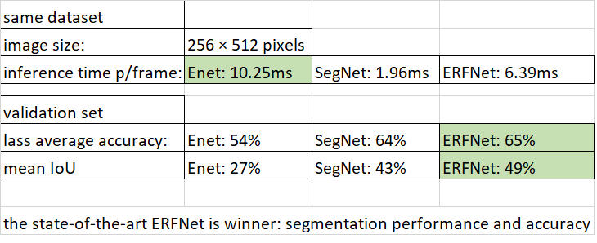
Test
Test result:
Terrain segmentation:
Evaluate terrain segmentation performance,
metrics are used: average accuracy and mean Intersection over Union (IoU)
On real-time three networks are compared: ENet, SegNet, and ERFNet
Notes:
terrain segmentation:
-to evaluate terrain segmentation performance, metrics are used: average accuracy and mean Intersection over Union (IoU)
-on real-time three networks are compared: ENet, SegNet, and ERFNet
Comp1
ENet: A Deep Neural Network Architecture for Real-Time Semantic Segmentation
perform pixel-wise semantic segmentation in real-time. ENet is upto 18x faster, requires 75x less FLOPs, has 79x less parameters and provides similar or better accuracy to existing models.
ERFNet: Efficient Residual Factorized ConvNet for Real-time Semantic Segmentation” (ERFNet)
uses residual connections and factorized convolutions, is proposed in order to remain efficient while retaining remarkable accuracy.
Segnet
upsample encoder output which involves storing the max-pooling indices used in pooling layer. This gives reasonably good performance and is space efficient
VGG16 with only forward connections and non trainable layers is used as ÷encoder. This leads to very less parameters.
Improved boundary delineation
Less number of parameters

Slide 11
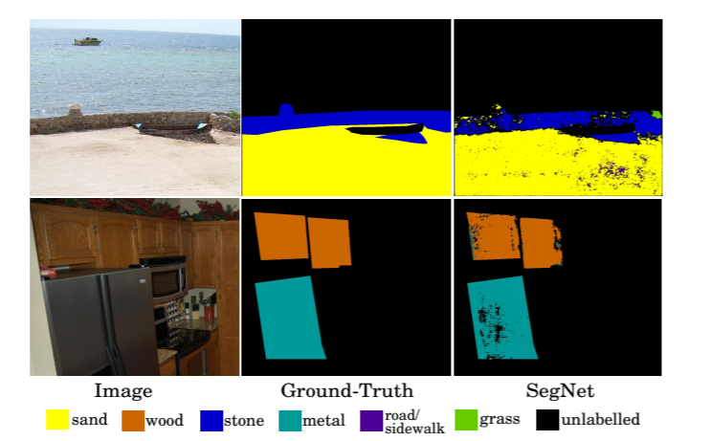
Test
freeze the first layer -> improve prediction performance
Terrain segmentation on validation images
Notes:
-it is found that predictions improve when we freeze the first layer of the convolution in the model
-Fig. 2 shows terrain segmentation example results on the validation images

Slide 12
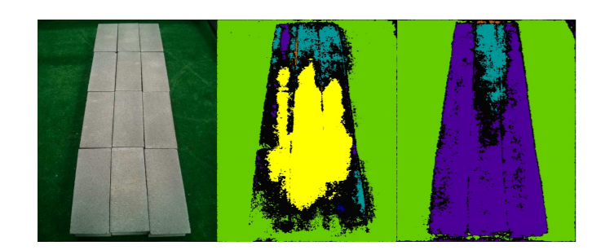
Test
Data augmentation: handle biases and ambiguous labelling
contrast and brightness moderate -> makes model more general and accurate
Notes:
-Data augmentation aids with biases and ambiguous labelling in the dataset
-Fig. 3 shows random variations in contrast and brightness moderate labeling ambiguity, and thus make the model more general and accurate

Slide 13
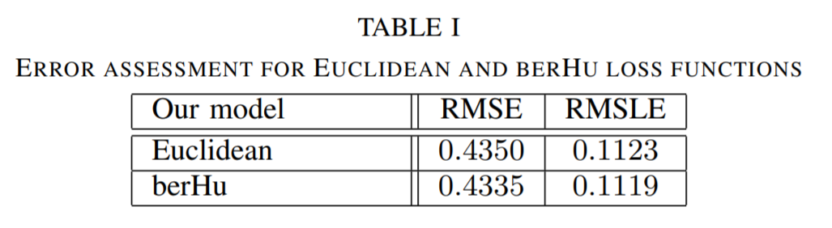
Test
terrain roughness:
metrics: the Root Mean Square Error (RMSE) and Root Mean Square Log Error (RMSLE)
Table on validation dataset: loss functions (Euclidean and berHu)
have similar estimation errors, berHu produces better results
Notes:
terrain roughness:
-to evaluate pixel-wise roughness regression, metrics are used: the Root Mean Square Error (RMSE) and Root Mean Square Log Error (RMSLE)
-Table I includes loss functions (Euclidean and berHu)
table1
on validation dataset
-the two loss functions have similar estimation errors, berHu produces better results

Slide 14
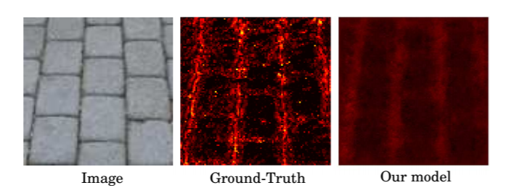
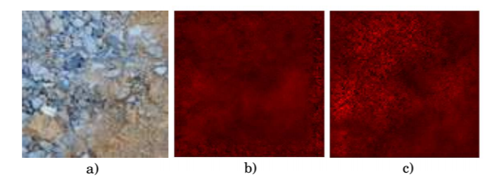
Test
Ground-truth depth data noise -> good quality of the roughness estimation
Flat surfaces: low roughness, boundaries: high roughness
Estimated roughness magnitude values were downscaled -> biases towards flat surfaces that dominate most of the dataset -> similar human vision system
appearance-based features > freshly trained models: biases are less
Notes:
-Fig. 4 shows that the quality of the roughness estimation is good, despite the variations due to ground-truth depth data noise from the SfM
-The flat surfaces have low roughness, boundaries have high roughness
-during regression the estimated roughness magnitude values were downscaled compared to the ground-truth, this is possibly due to biases towards almost flat surfaces that dominate m
-Fig. 5 shows These biases are less when the model is trained with appearance-based features compared to freshly trained modelsost of the dataset. This is not a problem since human vision system acts similarly

Slide 15
model applications on the robot
2 applications on robot CENTAURO for terrain segmentation and roughness estimation
-1st application: robot goes over terrain,
-detects rough surfaces
-changes its center of mass
-2nd application: robot goes over terrain,
-real-time algorithm
-changeable path planning
Notes:
-there are 2 applications on robot CENTAURO for terrain segmentation and roughness estimation
-1st: when robot moving towards the terrain, it detects rough surfaces and changes its center of mass status
-2nd: the robot moving towards the rougness terrain, it uses real-time algorithm for changeable path planning

Slide 16
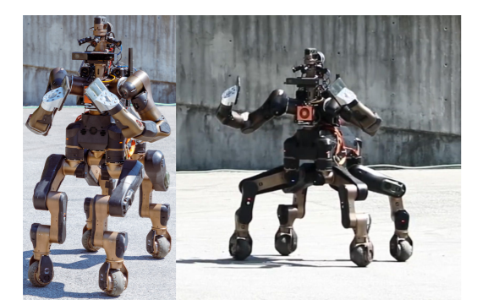
model applications on the robot
Robot features:
CENTAURO Robot:
wheeled-legged robot,
93kg,
1.5m height,
30 FPS RGB camera,
rotating (2rad/s) Velodyne VLP-16 RGB-D lidar sensor,
real-time segmentation and estimation
Robot Operating System (ROS) for control
CartesI/O interface: full 6D pose control, wheel steering and spinning

Slide 17
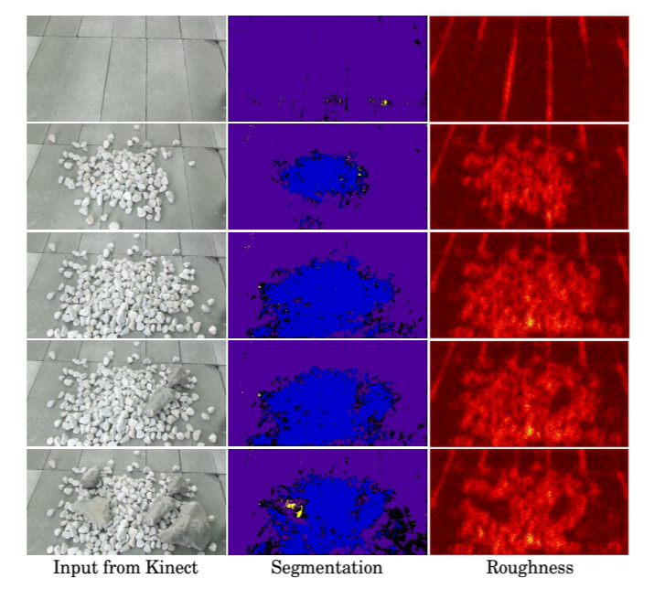
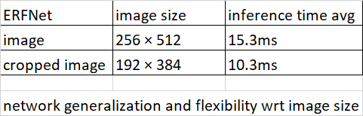
model applications on the robot
Real-time segmentation and estimation:
The figure shows experimental terrain segmentation and roughness estimation results
Motion blur effect
Notes:
real-time segmentation and estimation:
-Fig. 7 shows experimental terrain segmentation and roughness estimation results
-model generalization is focused on but there are some segmentation failures where some parts of large rocks may be confused with road/sidewalk surfaces due to similar appearance
table-comp2
-images of 256× 512 size, the inference time is on average 15.37ms using the ERFNet
-We have tested the time efficiency of the method for cropped 192 × 384 images in the robot’s closest observable area which improves the inference time by roughly 5ms
-this proves the generalization and flexibility of the network with respect to different image sizes
table-comp2
-Lastly, the camera’s motion blur affects the results and we leave the use of cameras with minimum blurring during motion as future work

Slide 18
model applications on the robot
1- Change of center of mass for robot balance:
Creatures keep balance:
1- increase polygon area
2-deacrese height
Apply same for robot
1- increase polygon area by its legs
2- decrease pelvis height
Notes:
change of center of mass for robot balance
-creatures like humans can keep their balance with increasing the polygon area by feet and deacresing the height
-robot decreases the pelvis height and increases polygon area by using its legs

Slide 19
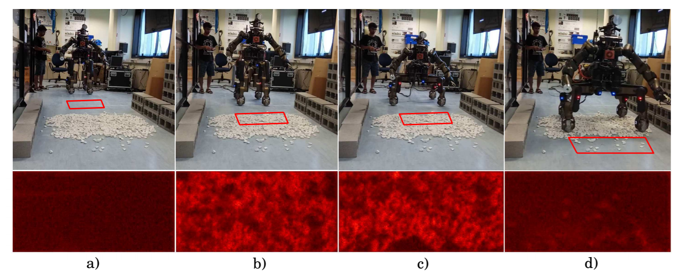
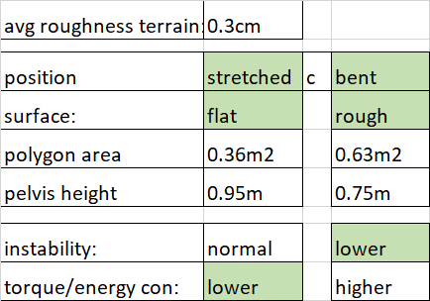
model applications on the robot
Robot positions for stretched and bent
Surface: flat and rough
Instability
Energy consumption
Rolling time before change
Notes:
-Fig. 8 shows
s
table comp3
we have realized the shaky instabilities of the robot rolling while keeping its legs straight over rough surfaces
-when the robot expands its support polygon by bending its legs the joint motors increase their torques, which results to higher energy consumption, unlike the case of straight legs, where the support polygon is much smaller but the produced torques are also minimal
-in the first experiments we allow the robot to move with stretched legs over flat terrain,
forming a support polygon of 0.36m2 with the pelvis height being 0.95m, while when very rough terrain is detected, we let the robot modify its support polygon using the CartesI/O module for better stability, with a 0.63m2 support polygon and 0.75m pelvis height from the ground. We also allow an intermediate level with pelvis height of 0.85m
-To drive the actions, a threshold of the average roughness of the upcoming terrain is required (we
experimentally set this to 0.3cm).
-Even though the roughness magnitude is approximated by our model, similar to humans perception, the relative roughness is enough to drive robot navigation.
-Notice that the robot requires some rolling time while changing its configuration, and thus we drive the support polygon change well before the front wheels reach the rough terrain
table comp3

Slide 20
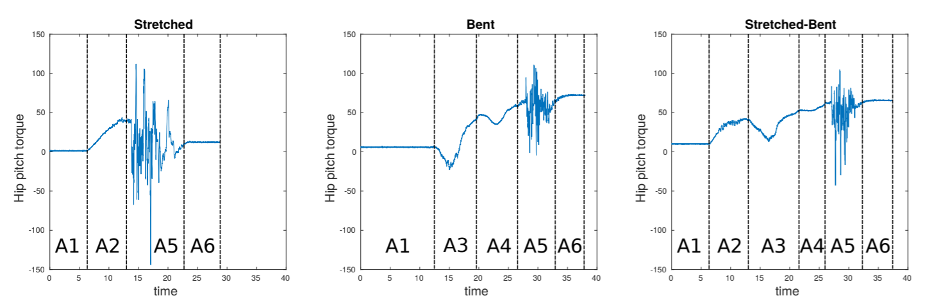
model applications on the robot
Three leg’s hip pitch torque
1- Stretched legs: flat surface and low torque vs rough surface and high torque fluct
2- Bent legs: flat surface and low torque vs rough surface and lower torque fluct
Flat surface: stretched leg. Roughness surface: bent leg for max balance, lower energy consumption
Notes:
-We run, three experiments with CoM variation being high (stretched), low (bent), and adaptable (stretched-bent)
-Fig. 9 shows the hip pitch (better for torque generation) torques of a leg during the experiments
-In the first experiment, the robot with stretched legs produces almost zero torques. However, when vibrating due to rough terrain instabilities, there are high torque fluctuations
-In the second experiment, the extended support polygon of the robot results in bigger energy consumption due to increased torques, but torque fluctuations over the rough surface are smaller, which results in rare loss of contacts with the ground
-As a result, it is clear that when in less rough terrain it is preferable to have the legs of the robot stretched and bend them for the upcoming rough terrains.
-In this way, maximum stability and minimum energy consumption is possible on the robot

Slide 21
model applications on the robot
2- Real-time changeable path planning
Robot: algorithm for changeable path planning
1- enlarge its polygon area -> large obstacles
2- narrow its polygon area -> constricted field
Algorithm:
1- roughness information + low-frequency (∼0.3Hz) lidar data
2- parallel process
3- path planning: three steps
Notes:
real-time changeable path planning
-robot applies algorithm for changeable path planning that enlarge its polygon over large obstacles and narrow its polygon in constricted field
-algorithm uses roughness information with low-frequency (∼0.3Hz) lidar data from lidar sensor
-parallel process so no need extra computation
-path planning algorithm has 3 steps for the test applications on robot

Slide 22
model applications on the robot
Step-1:
Create segmented map: use point cloud of lidar sensor
Map categorizes points
1- short obstacle < 0.4m -> clear area
2- high obstacle > 0.4m -> do not go
3- free area
Notes:
first step,
-segmented map is generated using the point cloud from the lidar sensor
-The map classifies points in the robot surrounding environments into three categories:
-1)short obstacle points <0.4m; these areas can be easily cleared or negotiated by the robot, 2) high obstacles >0.4m; these areas are non-traversable areas, and 3) completely free space points

Slide 23
model applications on the robot
Step-2:
Input: segmente map -> into A* planner
Check collision for point
1- avoid obstacle
2- enlarge legs and polygon area and go onto obstacle
3- narrow legs and fit into field
Check high obstacle
1- avoid obstacle
2- narrow legs and fit into field
Notes:
second step of the planning,
-segmented map acts as input to the proposed A*-based reconfigurable planner
-point is checked for robot polygon collisions with obstacles. In case a collision with a negotiable obstacle is exits, the planner selects from three strategies:
-1) avoid the obstacle, 2) expand over the obstacle to encompass it, such that the wheels roll on the sides of the obstacle, or 3) narrow into a polygon that doesn’t collide with the obstacle
-In case of a high obstacle, the robot avoids or narrows the polygon to fit into the free space

Slide 24
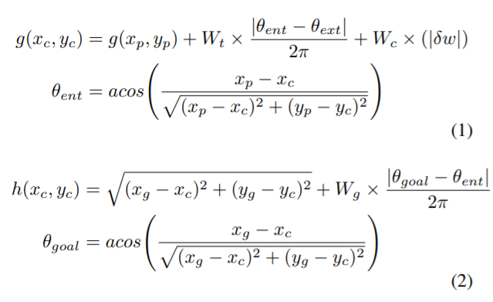
model applications on the robot
Decisions are computed by cost function;
Notes:
-The decisions are integrated into A* using the following cost functions
formula
(xp, yp) is the parent node (point in 2D segmented map)
and (xc, yc) is the target node currently being evaluated.
As in standard A*, the exact cost moving from the starting point to (xc, yc) is given by g(xc, yc) (Eq. 1)
and the heuristic estimated cost of moving to (xc, yc) with respect to the goal node (xg, yg) is given by h(xc, yc) (Eq. 2).
Wt is the weight on the cost of turning,
Wc is the weight on the cost of changing configurations,
|δw| is the change of the width of the robot polygon and
Wg is the cost of turning away from the goal

Slide 25
model applications on the robot
Step-3:
If not valid path exists -> get roughness information from segmented map (low obstacle info)
If roughness < 0.3cm -> make free for segmented map
Robot moves with lower velocity
Notes:
third step of the planning,
-when our A* planner is unable to find a valid path, the roughness information of the low obstacle points in the segmented map are obtained
-If these points that obstruct the robot’s path to the goal have small roughness 0.3cm, then we change the class of these points in the segmented map to free space points
-In this way the A* planner can plan paths through them, with an inferred lower velocity when traversing them

Slide 26
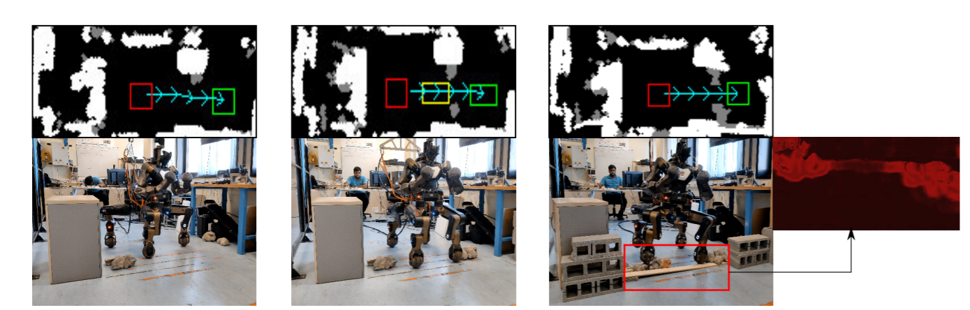
model applications on the robot
This shows navigation planning: 20ms valid plan, instant reply with 15ms estimate
1- avoid from obstacle
2- narrow legs
3- no path -> go onto obstacle
Notes:
-Fig. 10 shows three experiments to demonstrate the application of the roughness application for navigation planning
fig10
-left column depicts the case where the robot chose to avoid the rough obstacles as it had enough space, as observed from only the lidar point cloud data
-middle column depicts the case where the segmented map from only the lidar point cloud data shows that the robot is further limited in space and hence has to narrow to safely pass through the line of small rocks
-right column represents the situation where the planner has no possible path to reach the goal and hence, it uses roughness information of the low points and chooses to roll straight over the rough obstacles with low speed
fig10
-changeable planner on an average takes 20ms to give a valid plan or indicate the nonexistence of a safe valid plan
-With the roughness module providing roughness estimates every 15.35ms, it was possible to re-plan almost instantaneously without needing any extra processes, for the third case.
-This instant availability of roughness is bound to aid in the flexibility and dynamism for future planners

Slide 27
VIDEO ACTION
https://youtu.be/QSdB3DBuiu4

Slide 28
discussion
For the segmentation and estimation, end-to-end solution for thedifferent datasets is never stated on previous studies
The author uses an easy words and readable sentences not to cause fatigue
The architecture with previous studies on similar models and datasets are compared so that we can see difference between them and how the performance differ
This paper is mostly related to previous studies.
Therefore it may take more time for non-familiar researches unlessthey are familiar with these kind of studies

Slide 29
discussion
Modifying the number of the layers and bias values may improve the performance slightly
The algorithm should be improved in more difficult and cluttered and complex places
They can apply different future plans apart from their applications
If the robot hands become powerful enough, then the robot control better and performance can be improved effectively

Slide 30
CONCLUSION
Segment terrains and estimate their roughness by using end-to-end deep convolutional neural networks
Robot has autonomous planning and controlling for navigation
Enhance applications like speed configuration and path planning
It is well-proposed methods to optimize the robot planning
In the future, it should consider the complex and cluttered spaces

Slide 31
reference
[1] V. Suryamurthy, V.S. Raghavan, A. Laurenzi, N.G. Tsagarakis, D. Kanoulas “Terrain Segmentation and Roughness Estimation using RGB Data: Path Planning Application on the CENTAURO Robot”, 2019
[2] S. Bell et al., “Material Recognition in the Wild with the Materials in Context Database,” in IEEE CVPR, 2015, pp. 3479–3487.
[3] T.-C. Wang et al., “A 4D Light-Field Dataset and CNN Architectures for Material Recognition,” in ECCV, 2016, pp. 121–138.
[4] A. Howard and H. Seraji, “Vision-based Terrain Characterization and Traversability Assessment,” Journal of Robotic Systems, vol. 18, no. 10, pp. 577–587, 2001.
[5] J. Kim et al., “RGBD Camera Based Material Recognition via Surface Roughness Estimation,” in IEEE WACV, 2018, pp. 1963–1971.
[6] S. Ram, “Semantic Segmentation for Terrain Roughness Estimation Using Data Autolabeled with a Custom Roughness Metric,” Master’s thesis, 2018.
Notes:
I ll show this 2 min video at the end of the presentation

Slide 32
THANK YOU / questions

